Slide 1

Project Title -Netflix Content Analysis for Strategic Recommendations
[ Navinkumar Tirupati Tumma]
[INTERNSHIP_17546440516895be537820f]

Slide 2

PROBLEM STATEMENT
Netflix Content Analysis for Strategic Recommendations
To stay competitive, Netflix needs to strategically analyze its content library. This project addresses the challenge of understanding content trends by analyzing the distribution of movies vs.
TV shows, popular genres, and top content-producing countries. The goal is to provide data-driven recommendations to guide Netflix's future content strategy and ensure it meets the demands of a global audience.

Slide 3
Project Description
This project performs an in-depth analysis of the Netflix dataset, which contains information on over 7,000 titles from 2008 to 2021. Using Python and data visualization libraries, we explored three key areas:
The growth and distribution of movies versus TV shows over time.
The most popular and frequently occurring content genres.
The top countries contributing content to the platform.
The insights gathered from this analysis form the basis for strategic recommendations to help Netflix optimize its content acquisition and production efforts.

Slide 4

WHO ARE THE END USERS?
The insights from this analysis are valuable for several teams within Netflix, including:
Content Strategy & Acquisition Team: To make informed decisions on what movies and shows to license or produce.
Marketing & Production Teams: To understand audience preferences and tailor campaigns.
Business Executives: To guide high-level strategy for global market expansion.

Slide 5

Technology Used
Programming Language: Python
Libraries:
Pandas: For data loading, cleaning, and manipulation.
Matplotlib & Seaborn: For creating informative and visually appealing charts.
Environment: Google Colab / Jupyter Notebook

Slide 6
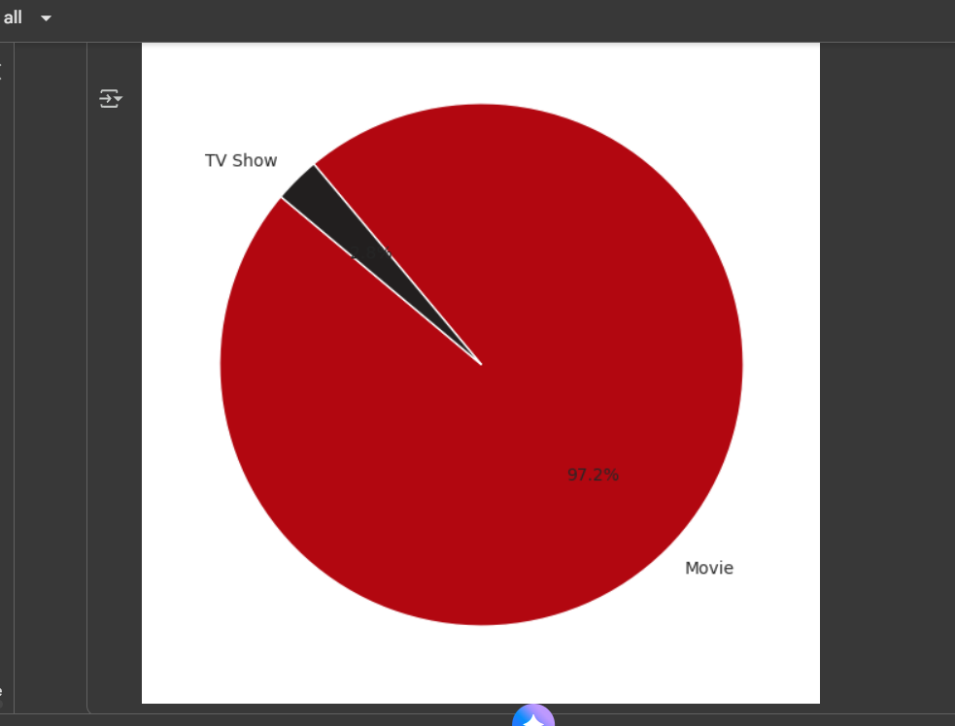
RESULTS1
[Add screen shots of your code or Chart(s) ]
Demo Link

Slide 7
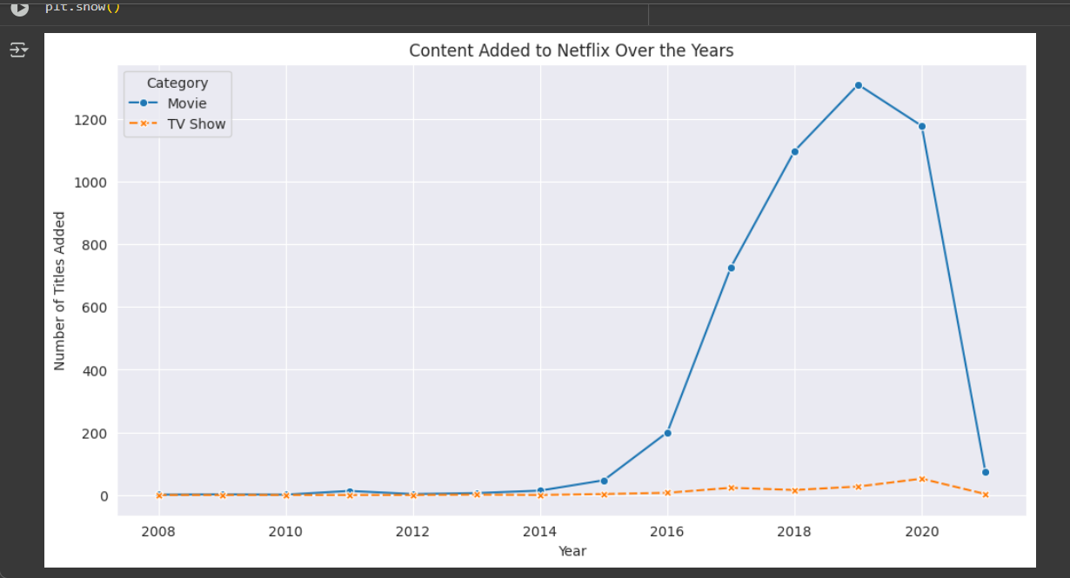
RESULTS2
Demo Link

Slide 8
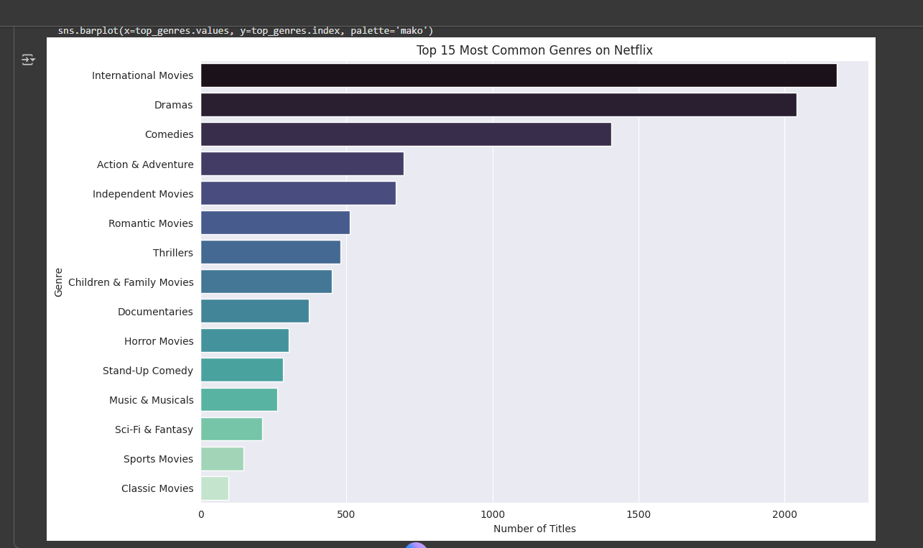
RESULTS3
Demo Link

Slide 9
GitHub repository
[https://github.com/777navin/VOIS_AICTE_Oct2025_Navinkumar_Major_Netflix_Data_Analysis.git]
Demo Link

Slide 10
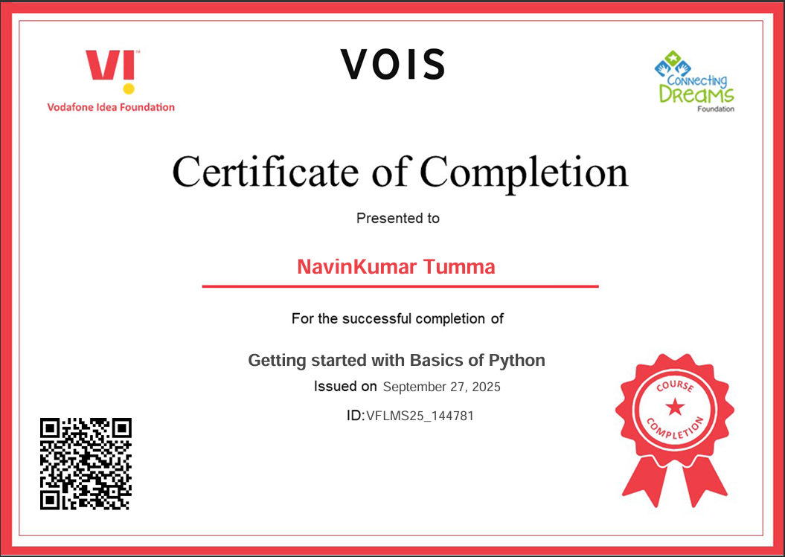
Getting started with Basics of Python Certificate

Slide 11
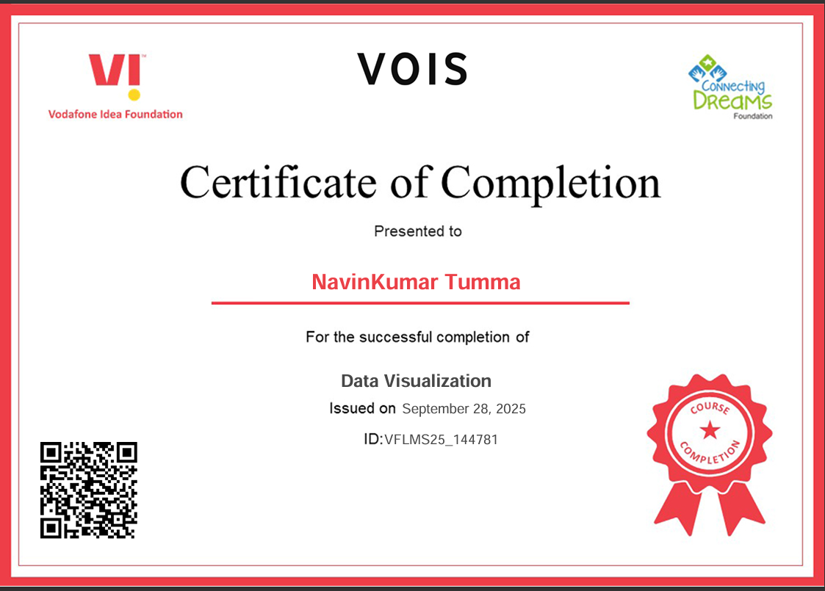
Data Visualization Certificate

Slide 12
Thank you
.
.

